Slide 1


Regression analysis on Black Friday dataset
Harshida, Jegadeesh Chandar
BDA 104
Predictive Model and Data mining

Slide 2


The Agenda
Choosing the data
Data cleansing/wrangling
Data Analysis
Feature engineering- 3 methods
Regression models- 3 models
Hyperparameter tuning-2 methods
Accuracy and justification

Slide 3
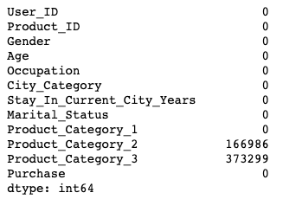
Data Wrangling
Target-Purchase
Columns
Replacing Nan’s with max value
Replacing Nan/s with 0
The latter gave better results

Slide 4
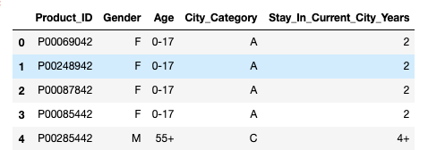
Data Wrangling
Columns having categorical values and objects as values
Label encoder and get dummies method
Label encoder method for values having more than 2 levels

Slide 5
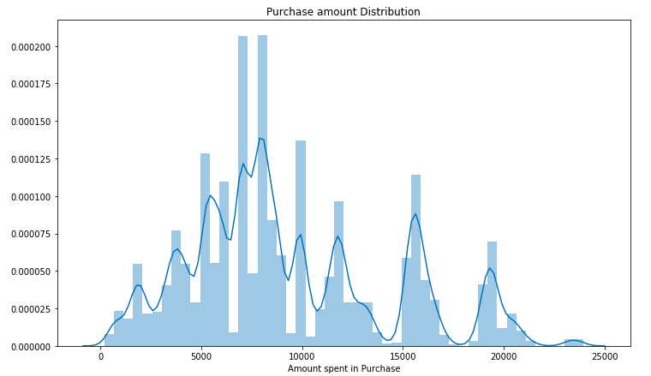
Data analysis
Top customers and top products based on the number of purchase
Determined the distribution of the target variable
Skewness=0.62427
Kurtosis=-0.34312

Slide 6
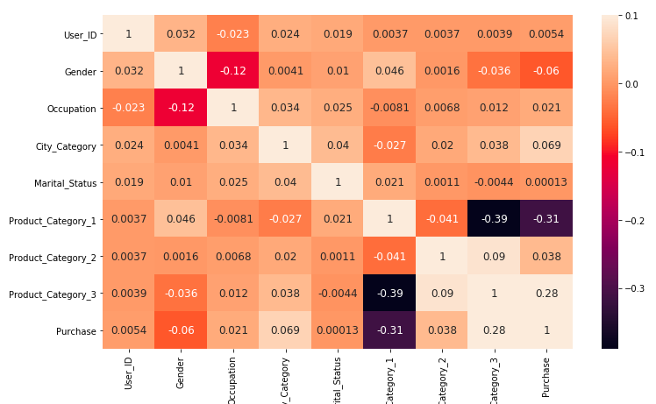

Correlation Plot
Negative correlations
Variables having the greatest impact on target
Multicollinearity

Slide 7
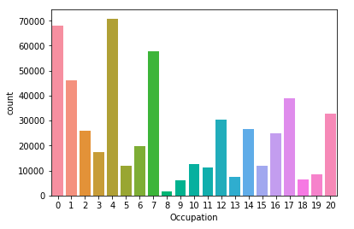
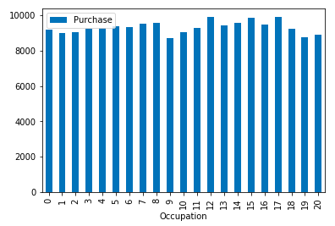
Analyzing Variables having high correlation coefficients
Occupation

Slide 8
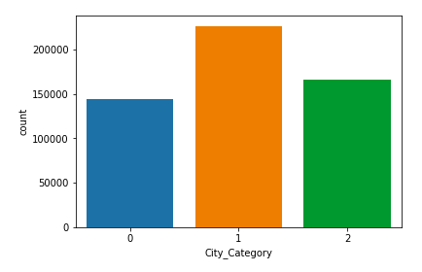
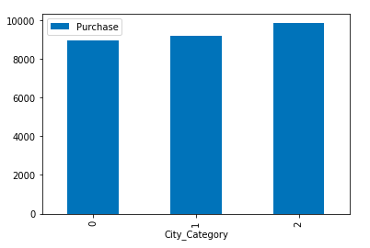
Analyzing Variables having high correlation coefficients
City Category

Slide 9

Feature Engineering
Variance Threshold
Threshold-0.8
Neglected- Gender, Marital status, City Category
Recursive Feature elimination
Linear model-selection 5
Selected-Gender, Age, City, Category, Product category 1, Product Category 3
RFE ranking

Slide 10
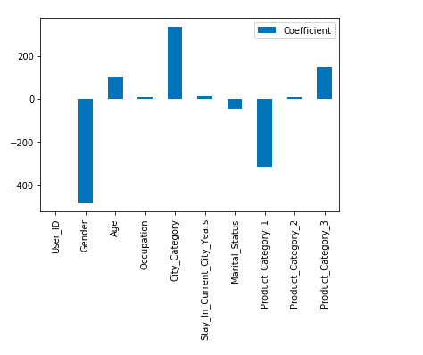
Feature Engineering
Dropping features having lowest value of coefficients using Linear regression model
Based on RFE, Variance threshold and variable coefficients-
We come to a conclusion that
User_ID
Occupation
Product_category_2 and
Marital_Status
will be dropped from the data to get better performance.

Slide 11

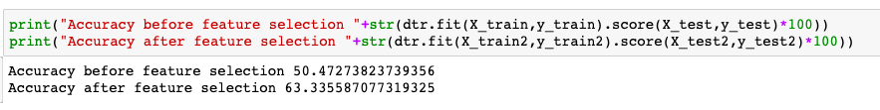
Decision Tree Regressor
Accuracy improved by at least 13 %

Slide 12
Regression models
Linear Regression
Ridge regression
Non-Linear Regression
Polynomial Regression
Classifier Regressors
Random Forest
Decision Tree

Slide 13
Ridge regression
Deals with multicollinearity
Not much difference in r2 score
The r2 score was around 13.252%
Bias Variance trade-off. Low r2 score model is not bad and high r2. r2 score model is not always good

Slide 14
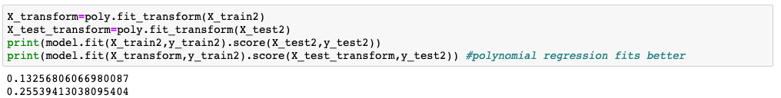
Polynomial regression
Deals with data having non-linear relationship
Degrees of non-linearity varies
2nd order polynomial regression
With the increase in degree the r2 score increase
For degree 6 –The r2 score was 41.5345%
But this is not good always as it captures the noise in the data (Overfitting)

Slide 15

Classifier regressors
While the classifiers can be used for classification problems they can also be used for regression problems
Random forest regressor
R2 score- 63.5813
Decision tree regressor
R2 score- 63.3352

Slide 16

Hyperparameter tuning
Steps:
get_params()
Create parameter grid
Initiate the parameter tuning method
Fit on the data
Get best_params()
Apply the parameters again to build the model and note the score

Slide 17
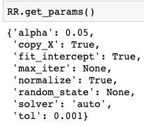
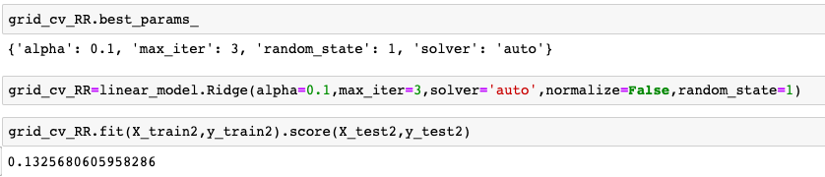
Ridge regression
There was not much change in the accuracy after parameter tuning

Slide 18
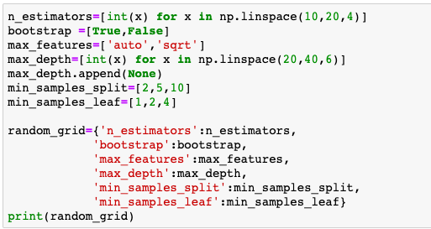
Random forest regressor with Randomized search CV
Hence there are 4*2*2*7*3*3 = 1008 combinations of features out of which the best has to be determined

Slide 19
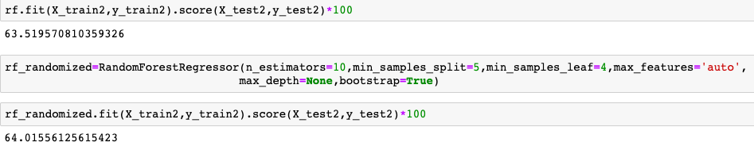
Random forest regressor with Randomized search CV
There was an improvement of 0.5% r2 score of the model (Random Search CV)

Slide 20
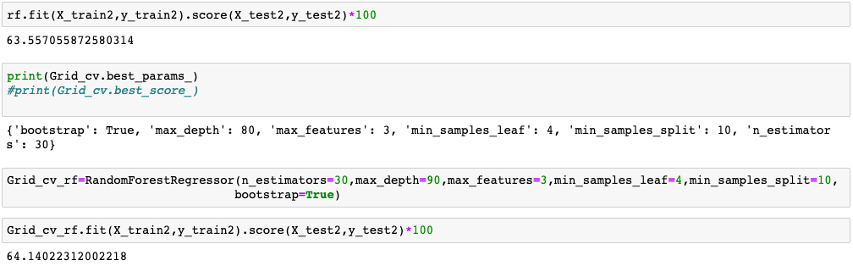
Random forest regressor - Grid Search CV
There was an improvement of 0.6% in r2 score of the model (Grid Search CV)

Slide 21
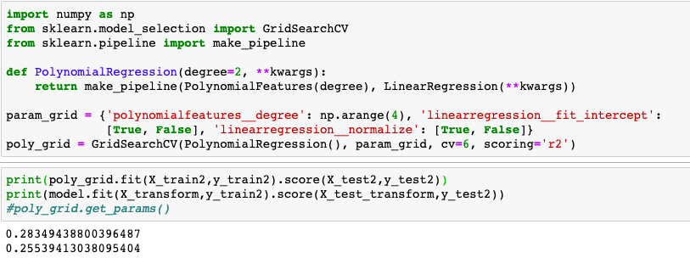
Polynomial regression with GridSearch CV
There was increase of 3% in the accuracy of the model after parameter tuning

Slide 22

Questions ?

